Slide 1
Chain Forward Risk Assessment & Profitability Study
Prepared by: Henry C. Dibie
Date: November 2025

Slide 2
Understanding the Chain Forward Challenge
Business Context & Objective
Forward Fintech is launching a short-term value-chain lending product for MSMEs.
This segment is highly risky due to:
Limited formal financial history
Volatile and irregular cashflows
High-frequency borrowing cycles
Value-chain interdependencies (cascade failures)
Objective of this analysis:
To determine whether Chain Forward can become profitable, and what risk controls, pricing strategies, and data science methods are required to make it viable.

Slide 3
End-to-End Risk Assessment Framework
Risk Assessment Framework (My Approach)
This analysis follows a structured 4-pillar risk framework:
Portfolio Viability Modeling
Evaluate losses, break-even default rate, and 3-year NPV.
MSME Behavioral Risk Analysis
Use alternative data: volatility, payment speed, partner risk, seasonality.
Customer Segmentation (K-Means)
Cluster MSMEs into 3 risk groups based on behavioral patterns.
Default Prediction Model (Logistic Regression)
Quantify which behaviors drive default risk.

Slide 4
Data Sources
1. Traditional Credit Snapshot (60-day)
Loan amount
Days in arrears
Utilization rate
Loan count
2. Alternative MSME Data (Simulated)
Cashflow patterns
Payment speed
Partner risk score
Platform activity
Final Modeling Dataset: 25,000 borrowers

Slide 5
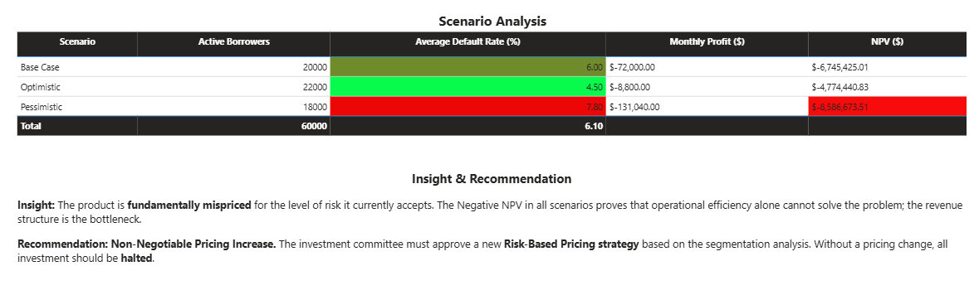
Profitability Results (Key Insight)
Product Profitability Is Negative Across All Scenarios
The Chain Forward product is unprofitable under current assumptions.
Even in the optimistic scenario, monthly profit remains negative.
Why?
High default rates + high LGD (80%)
Low revenue per borrower ($8/month)
Insufficient pricing relative to risk

Slide 6
Current Default Rate (6%) Exceeds Break-Even (3.75%)
Break-Even Analysis
Break-even default rate = 3.75%
Actual expected default rate = 6.0%
Chain Forward is operating 60% above break-even
No pricing structure can sustain this without segmentation
Conclusion:
➡️ Pricing must increase OR risk must decrease through selective lending.

Slide 7
Cashflow Volatility Is the Strongest Predictor of Default
Behavioral Risk: What Drives Default?
Low-impact predictors:
Traditional credit history features
Days Active on Platform
Top predictors (↑ default risk):
✔ Cashflow Volatility Ratio (strongest coefficient)
✔ Payment Speed (slow payments increase risk)
Interpretation:
➡️ Alternative data provides more power than traditional credit bureau data.

Slide 8
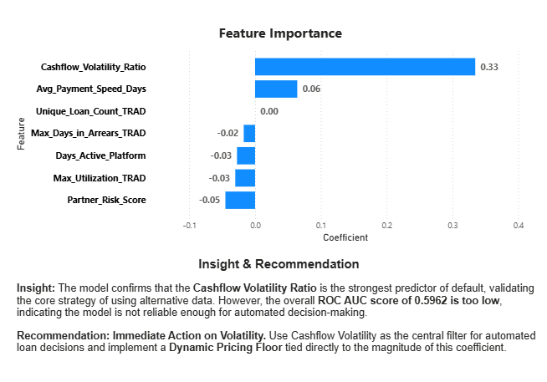
Cashflow Volatility Is the Strongest Predictor of Default
Logistic Regression confirms the importance of alternative data, but the model's overall predictive power is inadequate.

Slide 9
Customer Segmentation (K-Means)
Risk is Highly Concentrated in Segment 1
Segment | Default Rate | Portfolio Share | Interpretation
1 | 6.66% | 48.5% of customers | Very high risk
0 | 5.29% | 49% | Medium risk
2 | 4.0% | <1% | Low risk
Key Insight:
Almost half of all customers fall into the highest-risk segment, and this segment is the primary source of losses.

Slide 10
Segment Insights & Risk Strategy
Strategic Levers Based on Segment Risk
Segment 1 (High Risk)
High volatility
Slow payments
High partner risk
Action: Apply significant risk-based pricing OR restrict credit.
Segment 0 (Medium Risk)
Moderate performance
Action: Standard pricing + early warning signals.
Segment 2 (Low Risk)
Excellent payment speed, low arrears
Action: Offer lower pricing + increased limits.

Slide 11
Risk-Based Pricing Recommendation
Dynamic Pricing Is Required to Achieve Profitability
Pricing must be aligned with risk to recover expected losses.
Proposed Pricing Model:
Segment 1: +35–45% higher pricing
Segment 0: +10–15%
Segment 2: Discount or loyalty benefits
Rationale:
Losses are concentrated in Segment 1
Price adjustments increase revenue per borrower
Supports portfolio stability without mass rejections

Slide 12
Final Recommendations & Path to Viability
Strategic Path to Profitability
✔ Immediate Adoption of Risk-Based Pricing, Current product is fundamentally mispriced.
✔ Use Alternative Data Features Operationally, Cashflow Volatility → central decision rule.
✔ Deploy Early Warning Indicators, Payment delays, partner risk spikes, chain-level disruptions.
✔ Phase Out Highest-Risk Customers, Segment 1 must be priced higher or reduced.
✔ Re-evaluate portfolio with new pricing, Expected NPV should move toward positive territory.

